Slide 1
Notes:
Brief recap of how it came about and partnership effort locally.
- Sub group of Housing needs managers group
Presentation will cover following from the audit results
health service access and health status
Health related behaviours
Focus on supported and hostel accommodation
Each section in the report ends with summary and opportunities box for each section and these are highlighted
Next steps

Slide 2
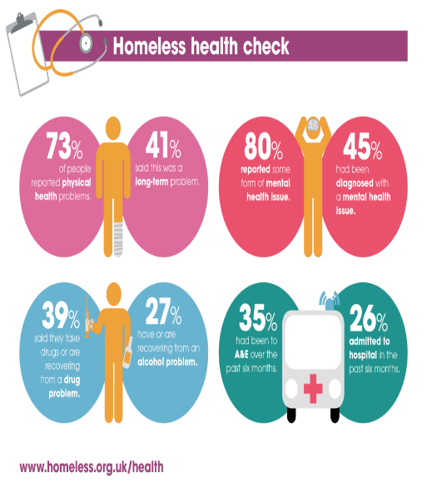
Homeless Link & the HNA
Usage at a national level
Creation of a national database of information about the health needs of homeless people.
Publication of the Unhealthy state of homelessness
Lobbying – figures on hospital discharge played a key role in our negotiations with the Department of Health prior to the launch of the £10m Homeless Hospital Discharge Fund
Notes:
Results are pooled nationally so being involved is of value nationally as well as locally as is used to define the issues nationally and adds weight to lobbying.
Approx. 27 areas have used tool so far and contributed so far.

Slide 3
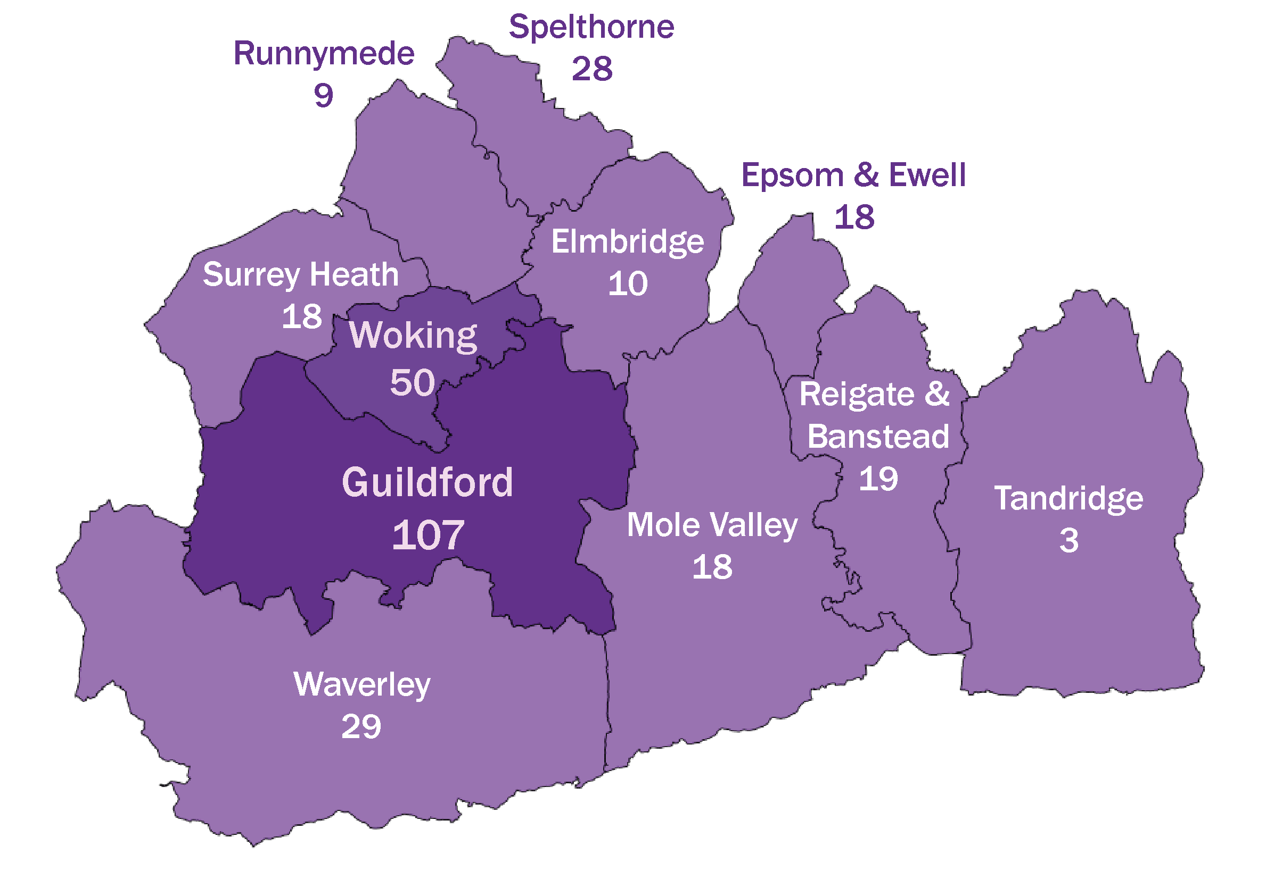
335 responses received
Notes:
Brief overview of who responded
Borough breakdown – no real suprises
329 full responses, others were only partially completed.
Mostly white male respondents eg. 1in 4 were female.

Slide 4
Accommodation status
Notes:
66% in supported accommodation / hotel
10% in emergency accommodation
7% in own tenancy
5% rough sleeping (although 20% had slept rough in past)

Slide 5
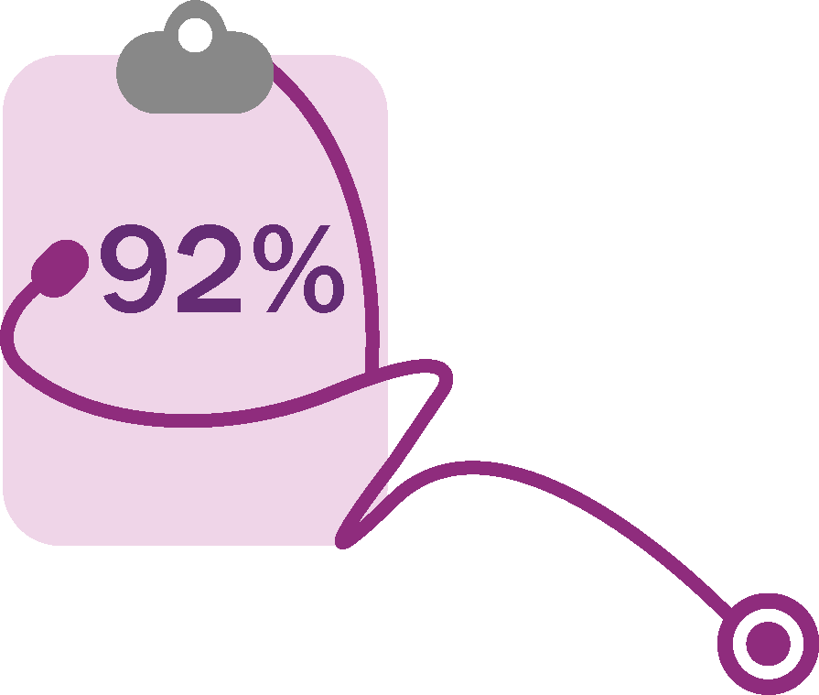
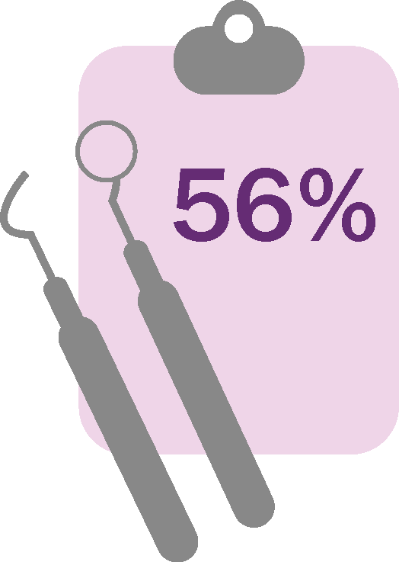
Health Service Use
are registered with a GP
61% have been to the GP over 3 times in the last 12 months
38% have been admitted to hospital in the last 12 months
36% used an ambulance, and 1 in 4 of those used more than 3 times in the last 12 months
are registered with a dentist
Notes:
Good level of repondents registered with a GP although of these only 32% registered with a GP signed up to the homelessness public health agreement service.
High level of use of primary care although not surprising given the health needs described in this audit
Also high hospital admissions and ambulance usage.
….This confirms high usage in this group of health services. The report provides comparison data where possible although directly comparable data is not always available.
Dentist – low registration. Eg. Scotland in general population registration is at approx. 84%.

Slide 6
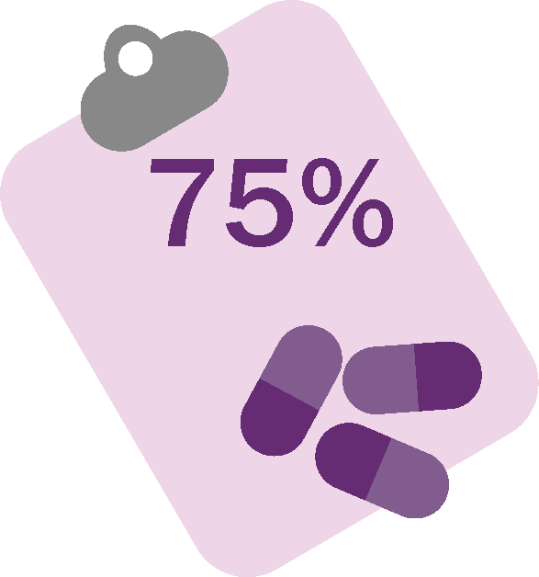
Health Status
77% have been diagnosed with depression; 61% with anxiety disorder or phobia
Receiving support/treatment to help with their mental health problem, but 2 out of 5 would still like more help
40% use drugs or alcohol to help them cope with their mental health
49% suffers from pain or discomfort
69% have long-standing illness, disability or infirmity
Notes:
Unsurprisingly mental health is a key issue here linked with other physical health problems
National HNA results indicate 34% diagnosed with depression and nationally in single figures (4-10%) so big difference with our result of 77%
Of those with MH problems, 83% stated they were getting some form of support. Of these 42% indicated they would like some more help – more work would be needed to understand this.
33% indicated that not able to get treatment / assessment when needed in past 12 months. Obviously subjective but is a significant proportion.
40% indicated that they also use drugs and alcohol as a coping mechanism for their MH issue making it of key concern.
Long standing illness also varied as compared to 41% in national HNA survey and 28% nationally. This compares to 69% in surrey HNA
In addition to the figures on the bottom of the slide ….. The most common physical problem = joint or musculoseletal – 38% and then after that it is dental at 34% again highlighting the issue of dental registration
33% had two or more physical health problems

Slide 7
Summary and opportunities
High usage of primary care, A&E and hospital admissions
High level of mental health problems with a large number indicating difficulty in accessing support or an assessment.
Need for further coordination of services in mental health and substance misuse.
Increase awareness of practices signed up to enhanced service
Low level of registration with a dentist indicating need to raise awareness of entitlement to dental services access and consider how specific barriers can be addressed.
Consider opportunities for supported accommodation as a setting to help people manage their health
Notes:
Run through summary and opportunities

Slide 8
Health related behaviours
38% eat one or less meals a day
1 in 3 never exercises for 30 minutes or more during the week
56% taken some form of illegal drug
14% acknowledged drinking problem (17% recovery)
78% Smoke & 46% of those would like to give up
31% think their health is worse than it was 12 months ago
Notes:
In addition to info in the slide, only 6% eating 5 portions, this compares to 52% in UK and 57% in surrey in 5 portions
In addition to those never exercising the audit indicates 45% exercised 3 or more times per week. This contrasts with 68% in surrey
Drug and alcohol use also much higher than surrey level - key issues re. Drug and alcohol use – linked to MH relate to earlier slide re. coping strategy
Smoking figure compares with 14 % rate in surrey so huge difference – however 46% want to give up indicating need to link in with stop smoking service.
Healthy lifestyle elements interesting as some might see health behaviours as lower priority with regards to someone who is in these circumstances. However clear that significant proportion would like help to give up smoking suggesting is an important area to consider re. opportunities.
A lot of people say health got worse however 69% think it is the same or better – more positive when we look at responses in supported accommodation.
(not mentioned on slide) Low completion of Hep B vaccine
Support is needed to help persons complete 3 stages of vaccine.
(not mentioned on slide) Low provision of flu vaccine
20% had receveid flu vac in last 12 months
Lower than other at risk groups
Need to acknowledge is not a recognised at risk group with regards to national free flu vaccination
Is highlighted to provide for those practices signed up to public health agreement but not automatic part of free flu jab programme

Slide 9
Summary and opportunities
High smoking rates, substance and alcohol use
Targeted promotion of stop smoking service / awareness of e-cigarettes re. harm reduction
Inform recommissioning of substance misuse services
Support high impact complex drinkers programme wider evaluation
Further develop joint working opportunities between mental health and substance misuse / alcohol services
Need to understand and address barriers experienced in accessing and completing vaccination programmes such (eg. Hep B and Flu)
Consider how healthy lifestyle programmes including healthy eating and physical activity can be tailored to provide relevant support
Notes:
Run through summary and opportunities
Opportunity for targeted work re. stop smoking. Need to raise understanding of e-cigarettes as are being increasingly seen as a means of harm reduction (95% less harmfull than smoking tobacco)
Explore how MH and SM service can further work together to support clients, recognising challenges that are often involved.
Inform recommissioning of substance misuse service in 17/18 and support for HICD wider evaluation

Slide 10
Hostel and supported Accommodation
66% of respondents in this position
Higher proportion having three meals but fruit and veg consumption low
Lower levels of physical activity
More likely to be registered with a GP and Dentist
Slightly lower levels of depression
No difference in those access sexual health check however awareness of service was higher
Larger proportion of smokers however also larger number wanting to quit
Lower use of A&E in the previous 12 months but no difference in readmission within 30 days
Higher numbers feeling overall health had improved compared with those in other circumstances
Notes:
66% of respondents in the accommodation type
More had three meals but lower fruit and veg consumption
Lower levels of physical activity seen in this group
Encouragingly they are more likely to be registered with a GP or dentist however dentist was still only at 55% meaning it still needs to be a focus going forwards.
Slightly lower levels of depression but still very high when compared to general population.
No real difference in access to sexual health checks however those in this accommodation showed higher awareness of where and how to access sexual health check
Raises issue as to how awareness is raised in those in other living arrangements?
While % of smokers was higher in this group (80%) the proportion wanting to quit was also higher at 70% suggesting these could be good settings for a targeted approach for the service?
Lower use of a and e in past 12 months but no difference in readmission rates
Overall 48% of those in supported / hostel accommodation felt health had improved compared with 22% in other living arrangements

Slide 11
Summary and opportunities
Health of individuals may have led to them being prioritised for accommodation
Less likely to access A&E in past 12 months although no difference was seen in 30 day re-admission rates again supporting building further links between health and housing .
Lower levels of mental health problems although still high compared to general population highlighting need for further development work.
Scope to increase awareness of and provide greater access to services to support healthier lifestyle choices where there are suitable settings to do so.
Opportunity to promote smoking cessation services
Work with outreach / support services to increase awareness of sexual health services
Notes:
Health status figures for those in supported accommodation did not significantly vary with regards to a number of indicators however this may well be due to the fact that poor health status may have prioritised their eligibility to supported accommodation.
Encouraging that lower use of A & E however would be good to understand this more. Also as re-admission rates were no different, what could be done to better support those following discharge into supported accommodation?
Not assume that health improvement is not a priority / possible for a person at different stage in process. Opportunity to see potential to better use this setting as a place to promote health improvement messages in a relevant way.
While % of those with MH issue was lower it is still much higher than general population emphasising need to continue to improve how people are supported in this area

Slide 12
Notes:
We are grateful to Edward Fram. PHd student who has compiled the bulk of the report.
An interactive tool will be available in Jan 17 on the housing section of Surreyi if there are particular provider or area based questions that it would be helpful to ask of the data).

