Slide 1
Housing: the national and regional context
Tony Travers
London School of Economics and Political Science

Slide 2
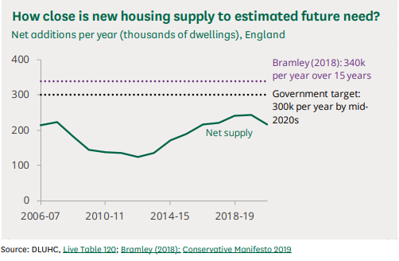
Housing ‘need’ and supply, England
Source: House of Commons Library

Slide 3
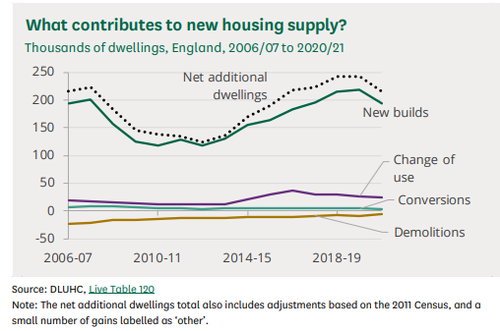
New build, change of use and conversions
Source: House of Commons Library

Slide 4
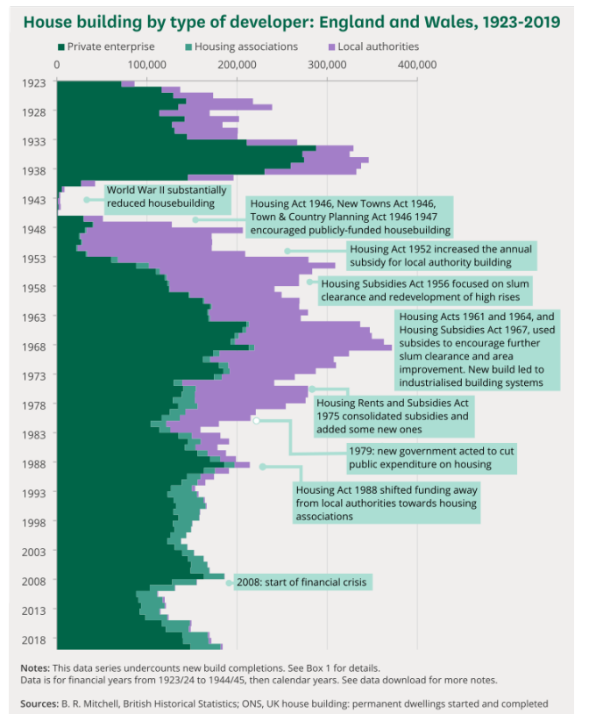
House building now mostly
by the private sector, very
different from the post-war
period
Source: House of Commons Library

Slide 5
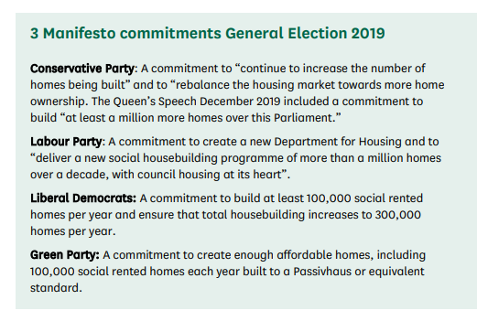
Parties’ commitments in 2019
- a million new homes/social homes over this Parliament/a decade
Source: House of Commons Library

Slide 6
Issues affecting house building in England
The population is increasing, especially in the wider south east
Housing is a way of building up capital where most other ways have become more difficult
Affordability (or the lack of it): the paradox of success
Green Belt
Opposition to development on green land
Rising interest rates after a decade + of very low rates
Intergenerational fairness
Economic competitiveness

Slide 7
The planning system
The 1947 Town & Country Planning Act effectively ‘nationalised’ decisions about land and building use
Councils and central government (both elected) now face endless ‘rationing’ decisions about housing subsidy, new development, heritage and taxation
Voters may accept the need for more housing but only “in the right places”
Recent weeks have seen a major struggle between the Government and its own backbenchers about ‘targets’
New demands (and short term costs) include embedded carbon, energy efficiency and aesthetics
Planning decisions about housing are important vote losers/winners

Slide 8
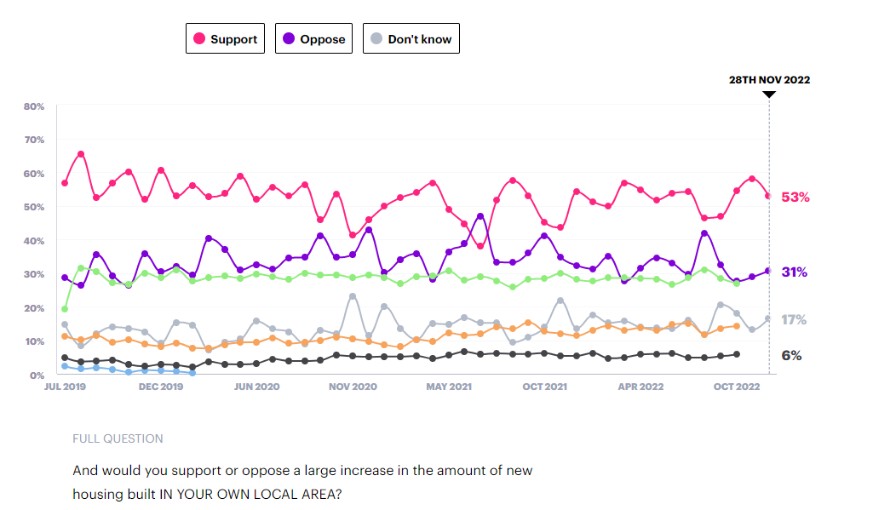
Support vs Oppose a large increase in housing locally
- London
Net 22% support a
‘large increase’ in
housing locally

Slide 9
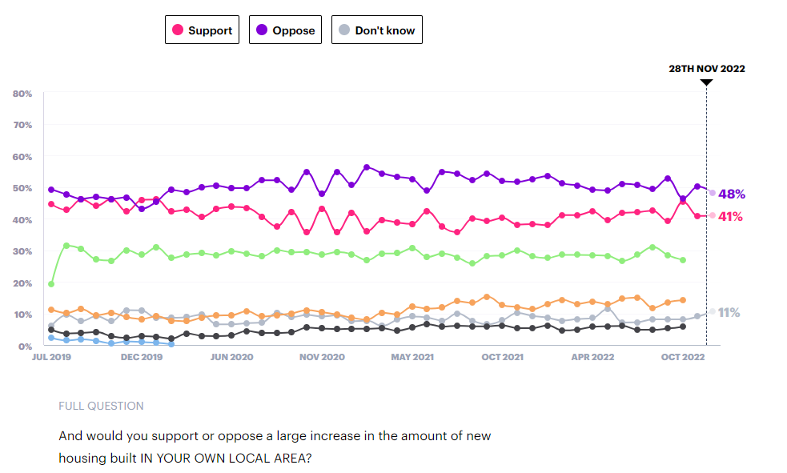
Support vs Oppose a large increase in housing locally
- South East, East & South West
Net 7% oppose
a ‘large increase’
in housing locally

Slide 10
Conclusions
Surrey needs more homes
New housing needs to be more ‘affordable’
Not much (apart from political grief) will happen unless local residents broadly assent to development
Demand will always exceed supply, so the key issue is how to protect those who currently do not own a home and/or live in place they reasonably like
On the bright side, many people are better housed in the UK than in the recent past
The politics of housing are both personal and political…

Slide 11
Housing: the national and regional context
Tony Travers
London School of Economics and Political Science

