Slide 1
Healthy Places
A toolkit for including health issues in Neighbourhood Plans
Public Health Team, Surrey County Council
April 2017
www.healthysurrey.org.uk

Slide 2
What does health have to do with Neighbourhood Plans?
Neighbourhood Plans can cover more than just where to build houses in your local area. They can also include proposals for ways to improve your local area, to help people live happier, healthier lives.
If your Neighbourhood Plan is adopted, your local planning authority will need to take it into account when making planning decisions. So you could influence future planning and investment decisions by saying what you want in your Neighbourhood Plan.
You may be able to put some of your proposals into action through your own Parish Council or Neighbourhood Forum, making use of any Community Infrastructure Levy Revenue you receive.
Your proposals will have more influence if they are backed up by evidence, and supported by your community. So it’s important to spend time gathering information and views, discussing options and setting priorities before you put proposals in your Neighbourhood Plan.
This toolkit will help get you started, and tell you where to go to get more information and guidance.

Slide 3
What helps people lead happy, healthy lives?
There are a range of factors that influence how happy and healthy people are.
Some we can’t change - such as inherited health conditions or disabilities.
Others we can try to improve in order to improve health and wellbeing.
These are factors to do with peoples’ lifestyle, connection to community, local economy, engagement in activities, built environment and natural environment.

Slide 4
What do people want from where they live, to lead happy, healthy lives?
Lifestyle – Access to affordable fresh food. Able to be physically active through easy access to open and green spaces, sports and leisure facilities. Safe and easy active travel. Able to achieve a good work/life balance.
Community – Able to connect with others through community and social networks and activities.
Local economy – Able to access a range of goods and services.
Activities – Able to participate in education, training or employment. Able to pursue personal interests and hobbies, develop knowledge and skills.
Built environment – Access to affordable, good quality housing. Safe and accessible community and public places. Easy access to health services. Safe and accessible pavements, cycle routes, roads and public transport.
Natural environment – Clean air, water and land; low ambient noise and radiation. Access to open countryside and natural landscapes.

Slide 5
7 steps to building health into your Neighbourhood Plan
We suggest you take the following steps, as part of your Neighbourhood Plan preparation:
Identify who lives in your area, and what needs they have.
Find out what health and wellbeing issues are important in your area.
Assess your neighbourhood and identify your main areas for improvement.
Generate ideas for improving your local area to meet health and wellbeing needs.
Work out which needs the ideas meet, and who they help.
Prioritise your ideas, for example by highlighting the ideas that benefit most people, in many ways and which are achievable and affordable.
Write these ideas (and the rationale behind them) into your draft Neighbourhood Plan, so you can consult people in your neighbourhood more widely.
As with the rest of your Neighbourhood Plan, it’s a good idea to do some of this work through community meetings, online collaboration, residents surveys, etc.

Slide 6
Who lives in your area and what needs do they have?
The things people need from where they live changes throughout their lives, and different people have different needs. Finding out who lives in your area is an important first step in finding out what is important to people now, and in the future. For example:
Children and young people – Being physically active is very important for children, but they are also more vulnerable to certain risks than adults, such as road traffic accidents and air pollution.
Working-age adults sometimes struggle to balance the demands of work and daily living. People who are out of work are more at risk of feeling socially isolated and depressed.
Older adults, especially those living alone, are more vulnerable to social isolation than working-age adults. It is important for their health that they remain physically and socially active.
People with disabilities or health conditions need easy access to healthcare services, but may be less mobile than others. It is important that facilities are designed to be accessible to them.
Parents and carers may spend a lot of time at home, and find it difficult to connect with others. They need options for exercise and self care that fit around their domestic responsibilities.
Disadvantaged or deprived social groups – some people find it harder to do the things they need to look after themselves, because of lack of money, awareness, family resources or stability.

Slide 7
Who lives in your area and what needs do they have?
You can see ward-level population data for Surrey (see example on following slides):
http://www.surreyi.gov.uk/ProfileBrowser.aspx?by=theme&pid=34&rt=37
Or get local population data at a different level of spatial aggregation (e.g. Parish):
http://www.surreyi.gov.uk/ProfileLocateTool.aspx
The Office of National Statistics provide local data on population, including information on social and economic wellbeing:
http://www.neighbourhood.statistics.gov.uk/dissemination/LeadHome.do?m=0&s=1485789944178&enc=1&nsjs=true&nsck=false&nssvg=false&nswid=1164
You can get visual summaries of this information in the ‘Surrey Snapshots’ (see example on following slides): http://www.surreyi.gov.uk/grouppage.aspx?groupid=58

Slide 8
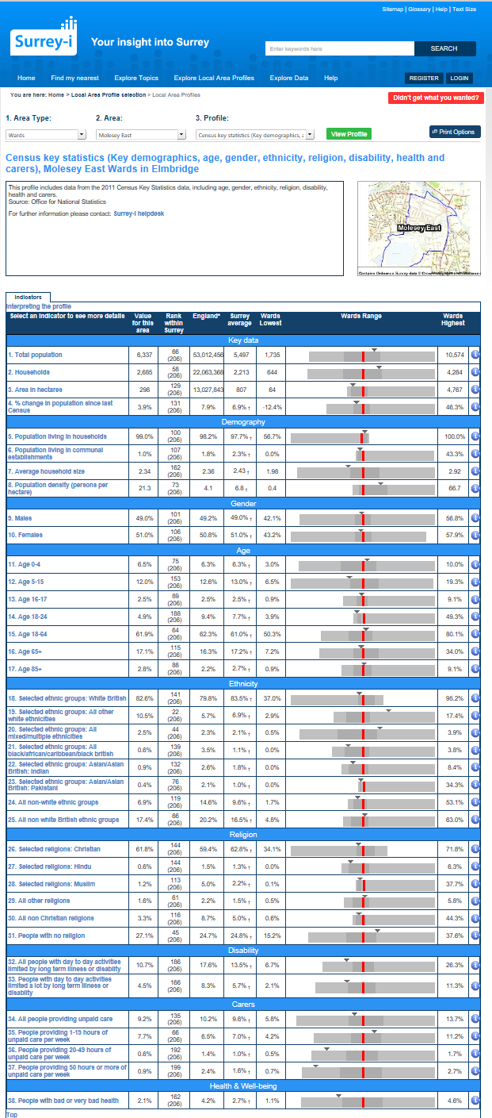
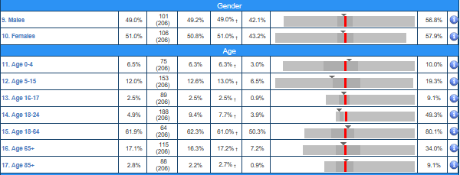
Ward-level population data: example from Surrey-i
http://www.surreyi.gov.uk/ProfileBrowser.aspx?by=theme&pid=34&rt=37

Slide 9
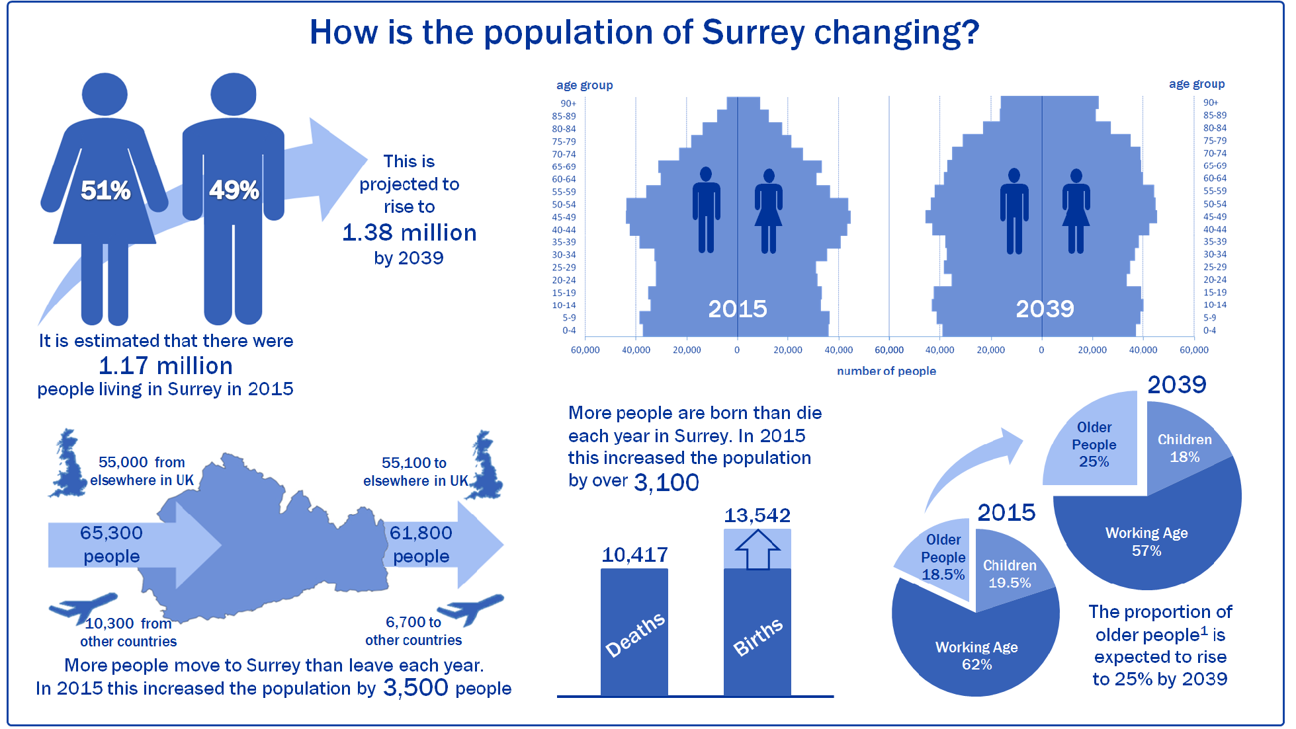
Surrey Snapshots - example from Surrey-i
http://www.surreyi.gov.uk/grouppage.aspx?groupid=58

Slide 10
What health and wellbeing issues are important in your area?
You can see an overview of health issues and needs in Surrey in the Joint Strategic Needs Assessment: http://www.surreyi.gov.uk/grouppage.aspx?groupid=36
‘Surrey Snapshots’, provide a visual summary of information on a range of health and wellbeing issues, (see example on following slides): http://www.surreyi.gov.uk/grouppage.aspx?groupid=58
For ward-level community wellbeing data (see example on following slides): http://www.surreyi.gov.uk/ProfileBrowser.aspx?by=theme&pid=27&rt=37
More detailed sources of local data on health and wellbeing:
‘Surrey Dashboards’ http://www.surreyi.gov.uk/grouppage.aspx?groupid=68
Public Health England Local Health http://localhealth.org.uk/#l=en;v=map11

Slide 11
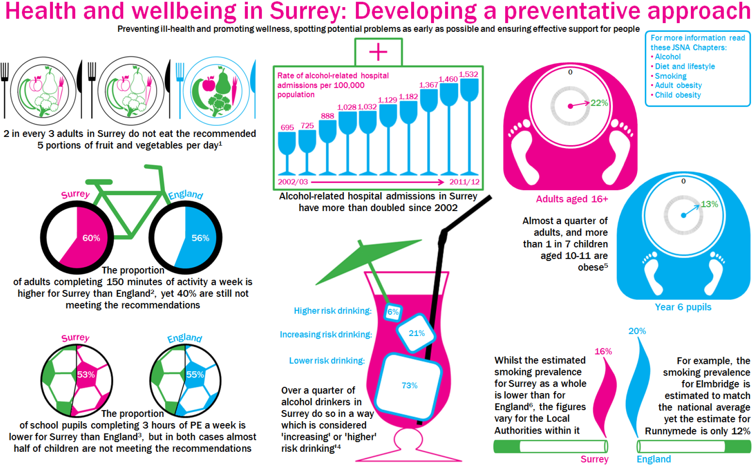
Surrey Snapshots - example from Surrey-i
http://www.surreyi.gov.uk/grouppage.aspx?groupid=58

Slide 12
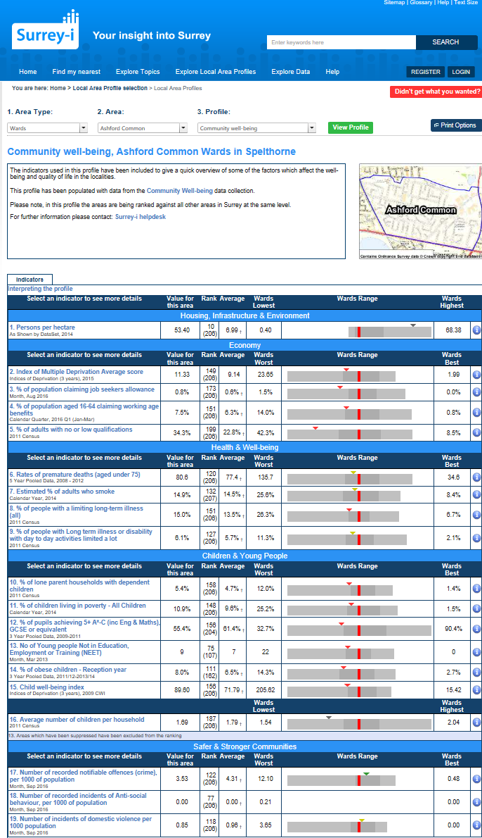
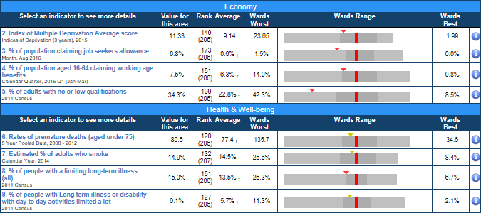
Ward-level wellbeing data - example from Surrey-i
http://www.surreyi.gov.uk/ProfileBrowser.aspx?by=theme&pid=27&rt=37

Slide 13
How good are your local facilities and services?
Many issues will be outside the influence of your Neighbourhood Plan, but think about your local area - is everyone able to:
Access affordable fresh food? Are there fresh food shops or markets within easy reach?
Be physically active everyday through easy access to open and green spaces, sports and leisure facilities? Are those green spaces and sports facilities well designed to promote physical activity?
Walk or cycle for local trips – are there safe, well lit and signposted routes, with rest stops?
Connect with others – are there community facilities and places for social activities? Are your public spaces such as shopping areas safe, attractive and accessible?
Access affordable, good quality housing?
Access more distant locations safely through driving or public transport? How safe and accessible are your roads and public transport options?
Access a range of goods and services – are there shops, health services, libraries, etc. within easy reach?
Access places where they can participate in education, training or employment; pursue personal interests and hobbies, develop knowledge and skills?
Access open countryside and natural landscapes? Are your local green spaces attractive and natural?

Slide 14
How good are your local facilities and services?
You can get information about public facilities & services on your local district or parish council website, or the Surrey County Council website: https://mycouncil.surreycc.gov.uk/mgListOutsideBodiesByCategory.aspx?bcr=1&CT=13114&META=mgboroughs
A really useful summary is available on the Surrey interactive map: http://surreymaps.surreycc.gov.uk/public/viewer.asp
You can check the location of local health services (including pharmacies, GPs, dentists, hospitals, etc.) at: http://www.nhs.uk/service-search/
For broader information on local health services, see websites for:
Surrey Health & Wellbeing Board http://www.healthysurrey.org.uk/
Local Clinical Commissioning Groups http://www.healthwatchsurrey.co.uk/content/commissioners-0
NHS Trusts http://www.healthwatchsurrey.co.uk/content/nhs-providers.

Slide 15
Generating ideas to meet local health and wellbeing needs
Now that you have identified major areas and opportunities for improvement you can go on to generate ideas for meeting local health and wellbeing needs. There are lots of organisations that provide guidance and ideas, such as:
Sport England – making your local area a better place to keep active and stay fit https://www.sportengland.org/facilities-planning/planning-for-sport/planning-tools-and-guidance/active-design/
Living Streets – helps local groups work out how to make their streets easier and safer for pedestrians to use. https://www.livingstreets.org.uk/
Sustrans – making highstreets places that work for the community http://www.sustrans.org.uk/our-services/what-we-do/route-design-and-construction/route-design-resources/ensuring-placemaking
Sustrans – building green spaces into local routes http://www.sustrans.org.uk/our-services/what-we-do/managing-land-biodiversity-and-wildlife-conservation
Brake – reducing speed limits to protect pedestrians and cyclists http://www.brake.org.uk/campaigns/flagship-campaigns/go-20
Royal Horticultural Society – Britain in Bloom & creating community gardens https://www.rhs.org.uk/communities
National Allotment Society – using and creating allotments http://www.nsalg.org.uk/

Slide 16
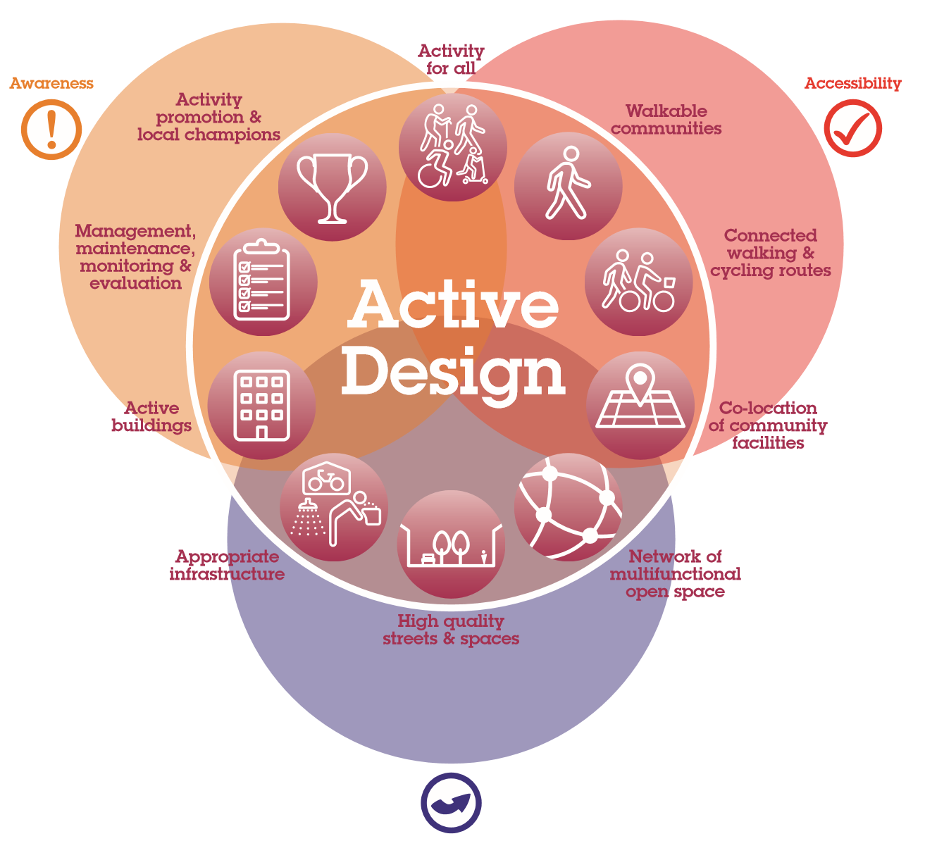
Get ideas from… Sport England

Slide 17
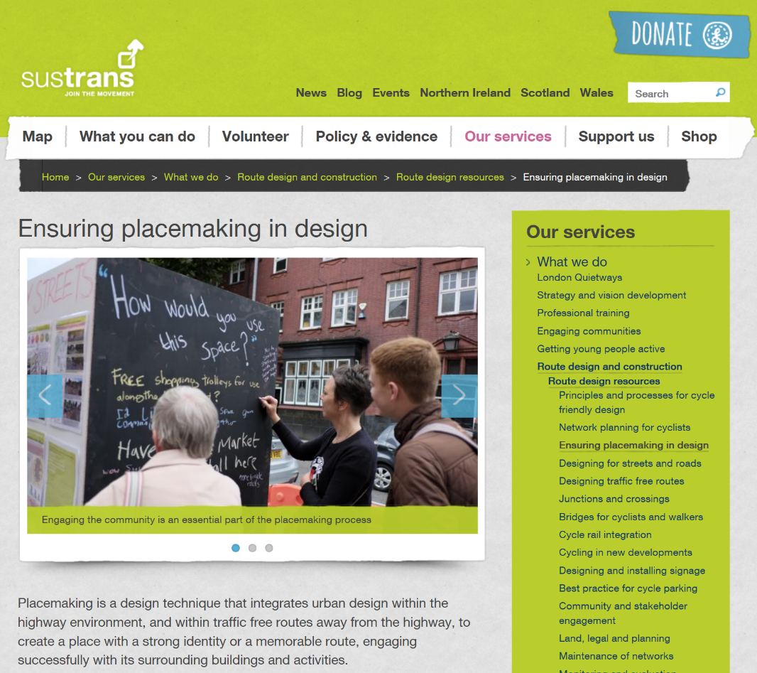
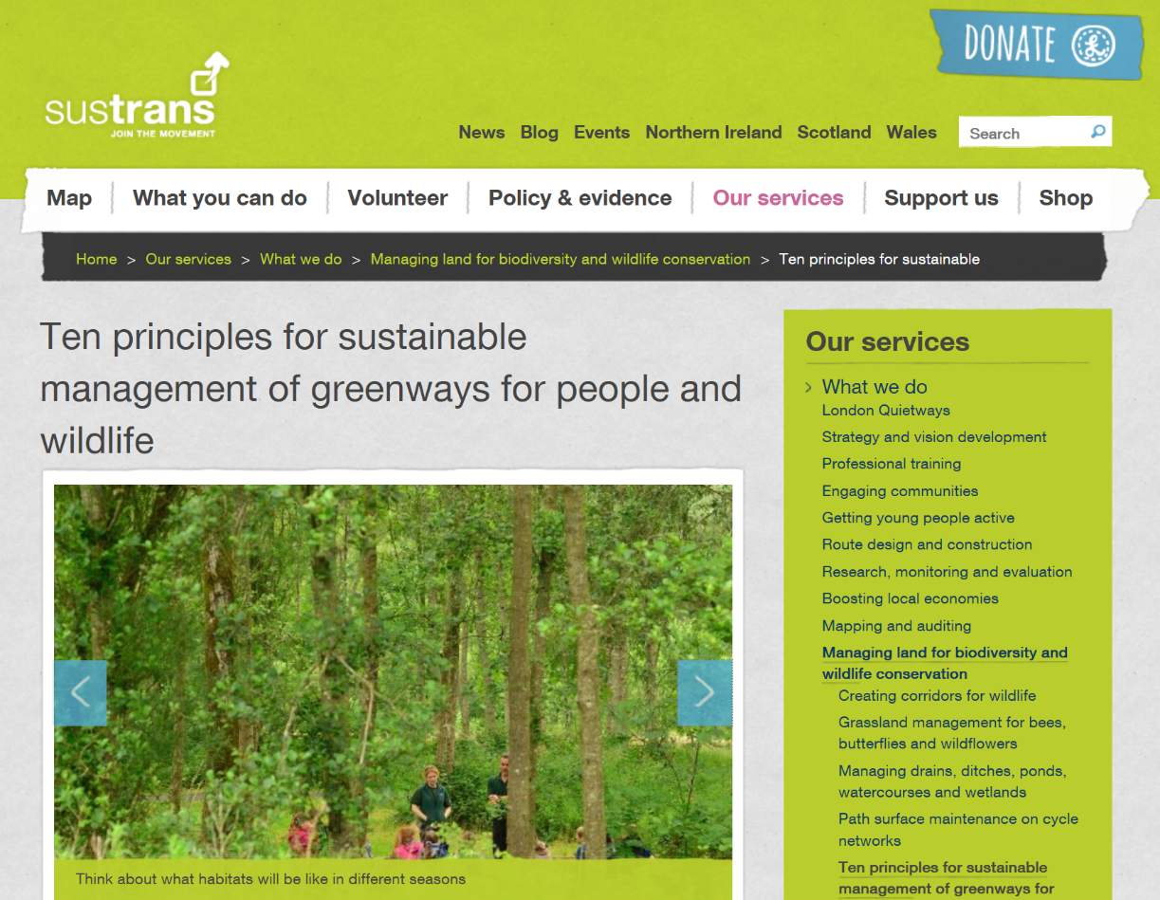
Get ideas from… Sustrans

Slide 18
Get ideas from… Go 20 campaign

Slide 19
What needs do your ideas meet, and who do they help?
Idea | Benefits | Children & young people | Working-age adults | Older adults | Disabled people | Parents and carers | Deprived social groups
20 mph speed limit | Make roads safer, quieter and reduce pollution | ✓✓✓ | ✓ | ✓✓ | ✓✓ | ✓✓ | ✓
Install outdoor gym in park | Encourage physical activity | ✓ | ✓✓ | ✓✓ | ✓ | ✓✓ | ✓✓
Work out which groups of people would benefit from your idea, and try to give a score for how much it would benefit them. You could use a table like this one to compare your ideas.

Slide 20
Prioritise your ideas
Idea | Benefits | Affordable? | Achievable? | Wide support? | Priority
20 mph speed limit | ✓✓✓ | ✓✓✓ | ✓✓✓ | ✓✓✓ | 1
Install outdoor gym | ✓✓✓ | ✓ | ✓✓ | ✓ | 3
Additional streetlights outside shops | ✓ | ✓✓✓ | ✓✓ | ✓✓ | 2
Start by comparing the benefits, affordability and achievability of each idea:
Does one idea benefit more people than another idea? Or would it have a greater impact on their health and wellbeing than another idea?
Is one idea very costly and another inexpensive?
Is one idea something you can do easily, whilst another idea looks difficult?
Which ideas do you think would gain wide support in your neighbourhood?
You can use a table like this one to give scores for each idea, and then use those scores to inform your prioritisation.

Slide 21
Write your ideas into your draft Neighbourhood Plan
If you’ve gone through all of these steps, you’ll have a lot to say in support of your ideas – how they’ll help meet people’s health and wellbeing needs, who they’ll help and how much, whether they are affordable, achievable and widely supported.
The next step is to consult more widely in your neighbourhood, to refine or change your proposals.
You can go back through the steps in these slides, to check any changes before you put your Neighbourhood Plan out for voting.
Good luck with preparing your Neighbourhood Plan, and helping people in your community lead happy, healthy lives!

Slide 22
Links to useful documents and information
Background information on Neighbourhood Plans:
http://planningguidance.communities.gov.uk/blog/guidance/neighbourhood-planning/
http://www.cpre.org.uk/resources/housing-and-planning/planning/item/2689-how-to-shape-where-you-live-a-guide-to-neighbourhood-planning
Local transport & development plans for Surrey and its Districts will provide some context for your neighbourhood plan:
https://www.surreycc.gov.uk/environment-housing-and-planning/planning/introduction-to-town-and-country-planning/development-plans/local-development-schemes
https://www.surreycc.gov.uk/roads-and-transport/roads-and-transport-policies-plans-and-consultations
Guidance on the importance of physical activity, and requirements for people in different age groups:
http://www.nhs.uk/Livewell/fitness/pages/physical-activity-guidelines-for-adults.aspx
https://www.gov.uk/government/publications/health-matters-getting-every-adult-active-every-day/health-matters-getting-every-adult-active-every-day
Guidance and ideas for healthy living:
http://www.healthysurrey.org.uk/
http://www.nhs.uk/livewell/Pages/Livewellhub.aspx

